Slide 1
Applied Statistics
Home Loan Analytics
Submitted By:
Malathi M

Slide 2
Objectives of assignment:
To identify the important factors which led sanctioning home loan for customer.
To check and validate statistically that the average loan amount across the gender and between people who are married and unmarried.
To identify any trend in properties for whom the loan has been sanctioned
To identify the probability of the customer getting loan amount.

Slide 3
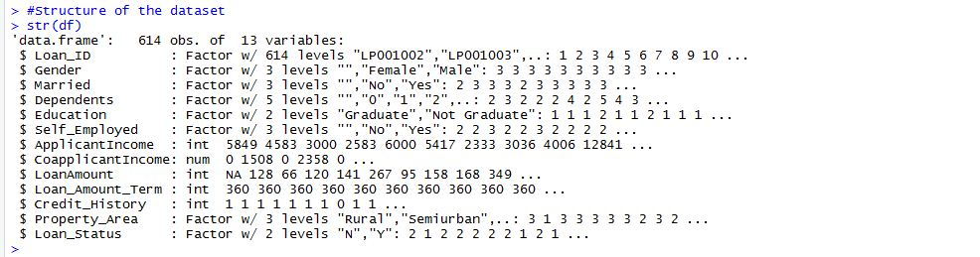
Data Set and Tool used
Tool used to achieve the objective is ‘R’.
The given data was in a form of “Data Frame”, having 614 observations and 13 variables.
The independent variable in the data is “Loan Status”.
Data has eight factor variables, four integer variables and on numeric variable.
Structure of the data :

Slide 4
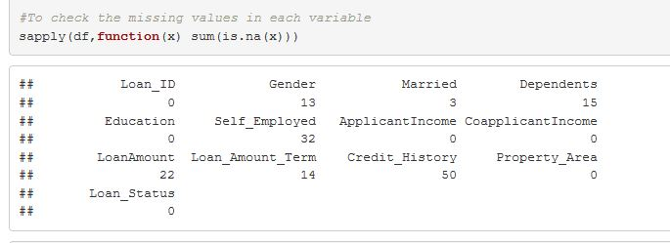
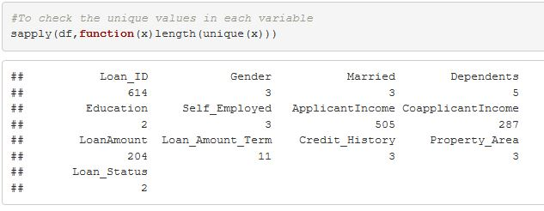
Data Set and Tool used
Number of missing values of each variable in each variable:
Number of unique values of each variable:

Slide 5
Data Preparation
Replacing the missing values for the variable ‘Gender’ , ‘Married’ and ‘Dependent’ by mode of respective variable as these variables are categorical.
Replacing missing value of ‘self-employed’ based on the ‘education’ level of that person.
Replacing missing value of ‘loan amount’ and ‘loan amount term’ by median of respective variable as these are numerical variables.
Replacing missing ‘credit history’ based on ‘loan status’.
Applying log transformation for variables ‘Loan Amount’, ‘Applicant Income’ and ‘Co-applicant Income’ to create normal distribution of the variable.

Slide 6
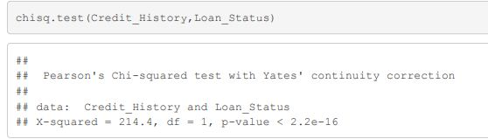
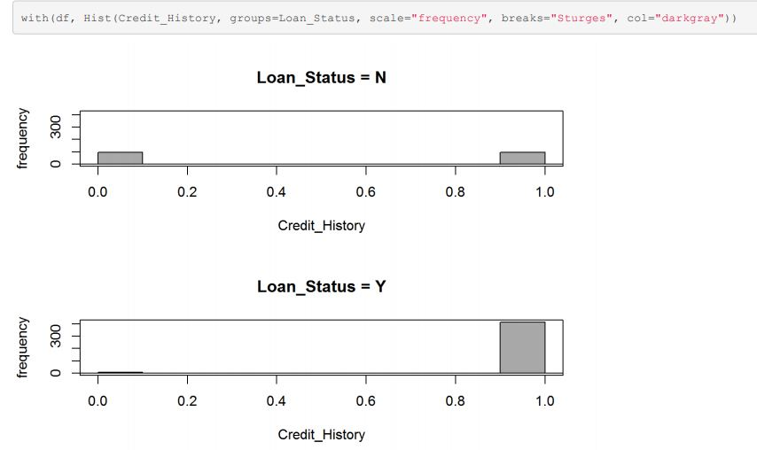
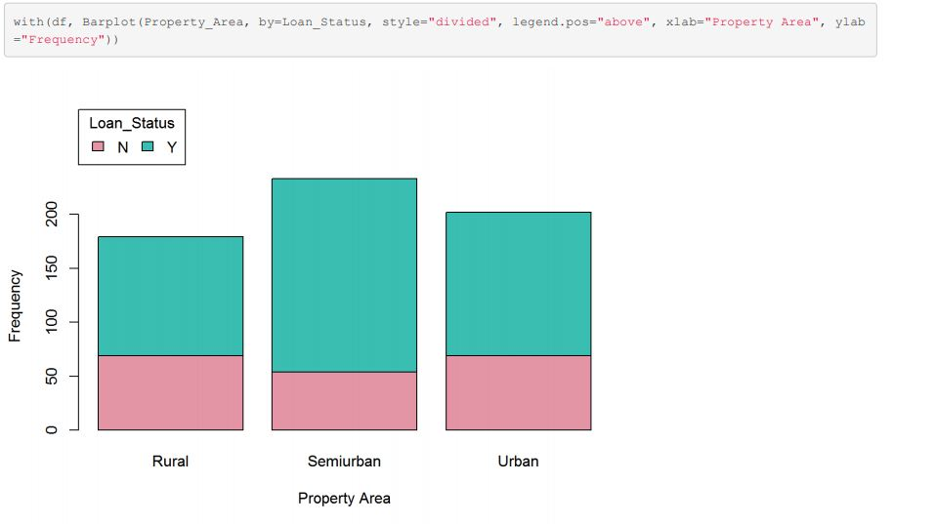
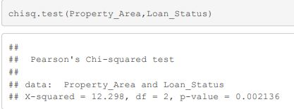
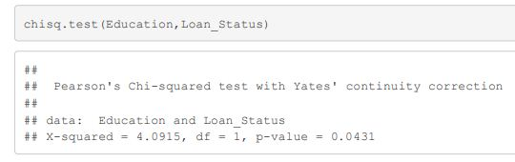
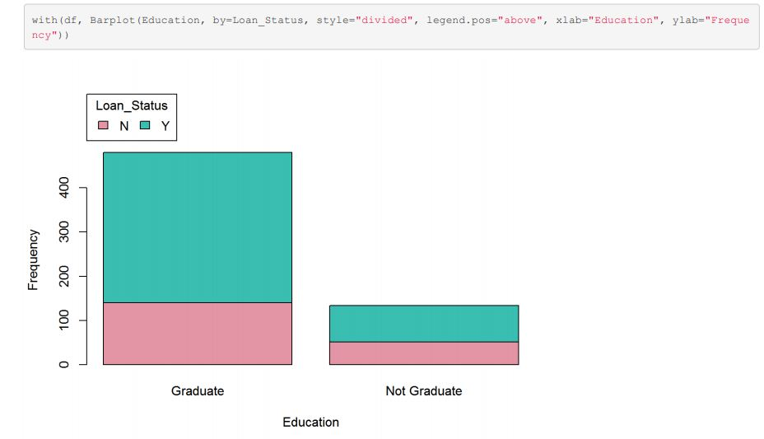
To know the factors for sanctioning loan
Factors for sanctioning loan for the given customer based on Chi-Square Value are:
a. Credit History
b. Property Area
c. Education

Slide 7
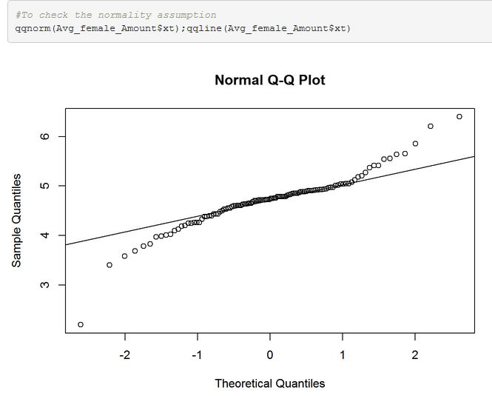
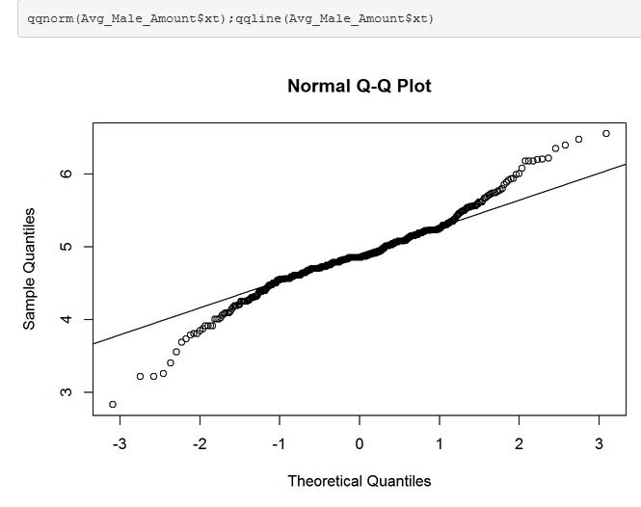
To check average loan amount across gender and marriage and validate statistically
To check whether the average loan amount is same across the gender by performing Two Sample Students' T-Test
a. Q-Q plot for loan amount for both genders
To check the normality.
b. Leven’s Test to check the homogeneity
in variance p value is 0.8434 which is greater than 0.05.Hence homogeneity in variance is assumed.
c. Performing Two Sample Student’s T Test to check the average loan amount; p value = 0.0003649 ,p-value is less than 0.05. Hence there is significant difference between the average loan across the gender.

Slide 8
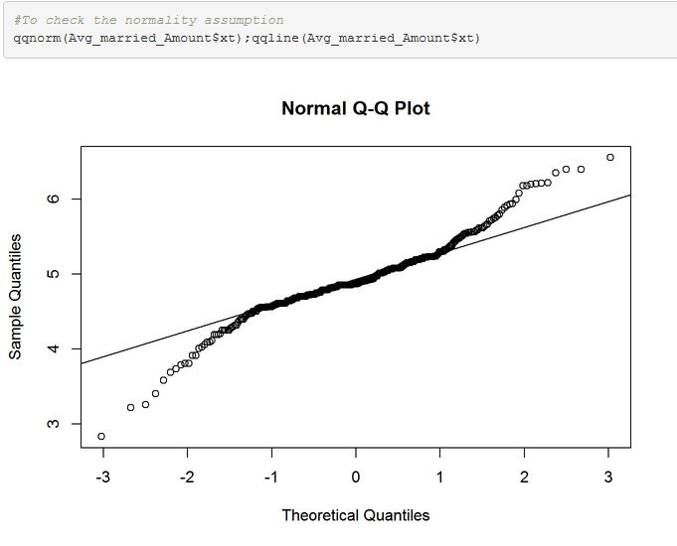
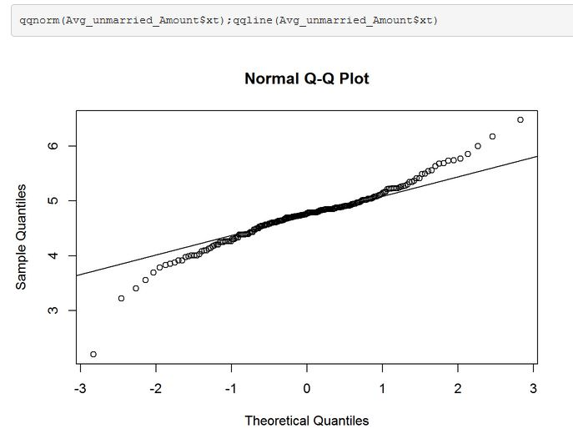
To check average loan amount across gender and marriage and validate statistically
To check whether the average loan amount is same between married and unmarried people by performing Two Sample Students' T-Test
Q-Q plot for loan amount for married and
Unmarried to check the normality.
b. Leven’s Test to check the homogeneity
in variance p value is 0.5819 which is greater than 0.05.Hence homogeneity in variance is assumed.
c. Performing Two Sample Student’s T Test to check the average loan amount; p value = 7.366 x e^-6 ,p-value is less than 0.05. Hence there is significant difference between the average loan between married and unmarried

Slide 9
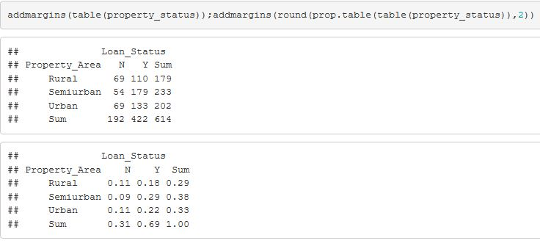
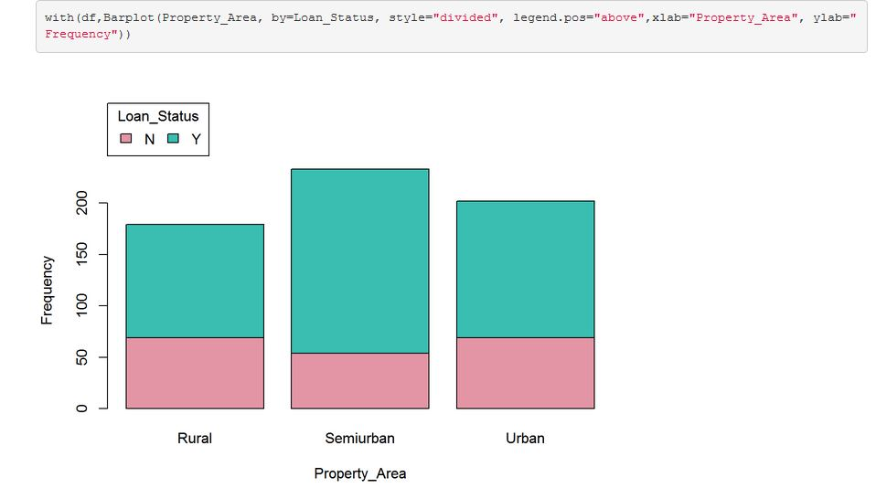
To know if there is any trend in property area
Loan have been sanctioned more for semi urban property and also the number of applicants are more from semi urban property holders.

Slide 10
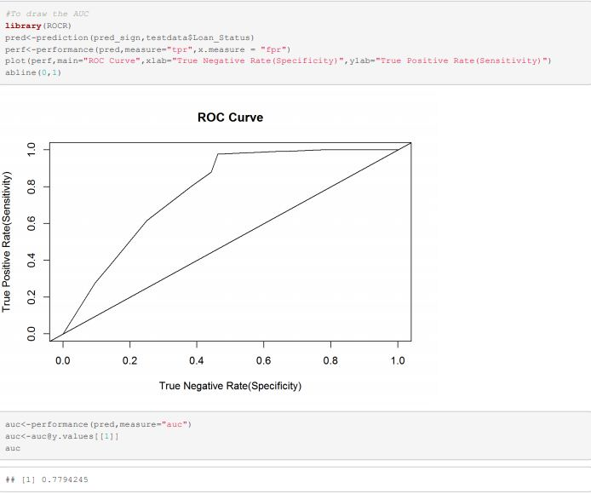
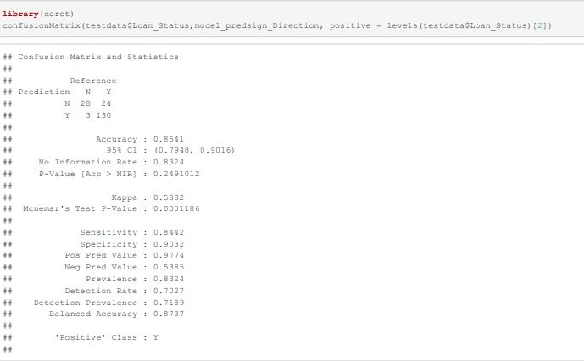
To predict the probability of loan getting sanctioned
Using ‘Logistic Regression’ to predict the probability of customer getting loan
Minimum optimal cut off considered is 51% for class probability
Instead of probability each class id predicted for final outcome with accuracy of 85.4% and AUC of 77.94%
Confusion Matrix and ROC Curve

Slide 11
GitHub Link: https://github.com/MalathiMuniraju/hello-world/blob/master/Appplied%20Stats%20Assignment.pptx

Slide 12
Thank You

